Slide 1

WEEK-10 Prepare project documentation. ONLINE LOAN APPLICATION 190030937-SHREYA
BATCH – 06

Slide 2

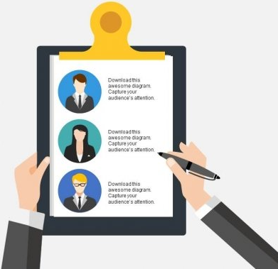
TEAM MEMEBERS
Enterprise programming – Online loan application project
ADMISSION NUMBER | NAME
190030937 | SHREYA LANKAPALLI
190030921 | KETHEPALLI VENKATA LAKSHMANA PRAVEEN
190030858 | SUREKHA KOPURI

Slide 3

LOANS IN BANK
ABSTRACT
BANK LOAN
A bank loan is an amount of money borrowed for a set period within an agreed repayment schedule. Borrowed money can be used for many purposes, from funding a new business to education
In finance, a loan is the lending of money by one or more individuals, organizations, or other entities to other individuals, organizations etc. The recipient incurs a debt and is usually liable to pay interest on that debt until it is repaid as well as to repay the principal amount borrowed
Banks usually look at the 5 C's of credit i.e., capacity, collateral, capital, character, and conditions while evaluating your personal loan application.
“Timely return of a loan makes it easier to borrow a second time”

Slide 4
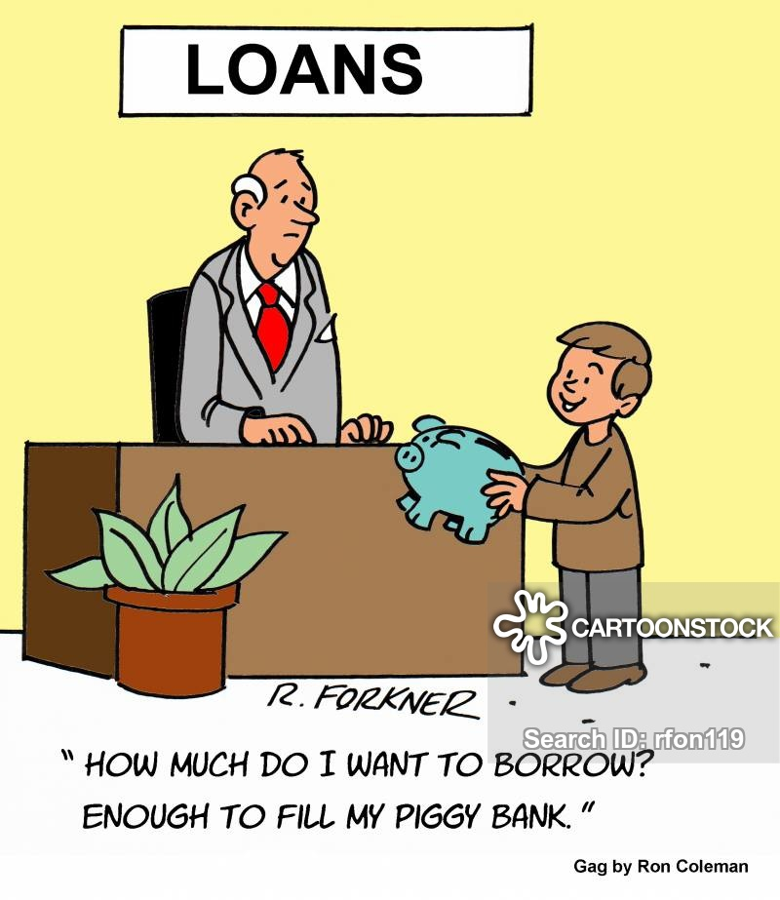
TYPES OF LOANS
Personal Loans
Most banks, online and on Main Street, offer personal loans, and the proceeds may be used for virtually anything from buying a new 4K 3D smart TV to paying bills. This is an expensive way to get money, because the loan is unsecured, which means that the borrower doesn’t put up collateral that can be seized in case of default, as with a car loan or home mortgage
Credit Cards
Every time a consumer pays with a credit card, he or she is taking out a personal loan. If the balance is paid in full immediately, no interest is charged. If some of the debt remains unpaid, interest is charged every month until it is paid off.
Home-Equity Loans
People who own their own homes can borrow against the equity they have built up in them. That is, they can borrow up to the amount that they actually own. If half of the mortgage is paid off, they can borrow half of the value of the house, or if the house has increased in value by 50%, they can borrow that amount.
Personal Loans
Credit Cards
Home-Equity Loans
Business Loans
Small Business Loans
Educational loan

Slide 5
TYPES OF LOANS
Business Loans
A business loan is a loan specifically intended for business purposes. As with all loans, it involves the creation of a debt, which will be repaid with added interest. There are a number of different types of business loans, including bank loans, mezzanine financing, asset-based financing, invoice financing, microloans, business cash advances and cash flow loans.
Small Business Loans
Small business loans are available through most banks and through the Small Business Administration (SBA). These are typically sought by people setting up new businesses or expanding established ones.
Educational loan:
An education loan is a sum of money borrowed to finance post-secondary education or higher education-related expenses. Education loans are intended to cover the cost of tuition, books and supplies, and living expenses while the borrower is in the process of pursuing a degree
Personal Loans
Credit Cards
Home-Equity Loans
Business Loans
Small Business Loans
Educational loan

Slide 6
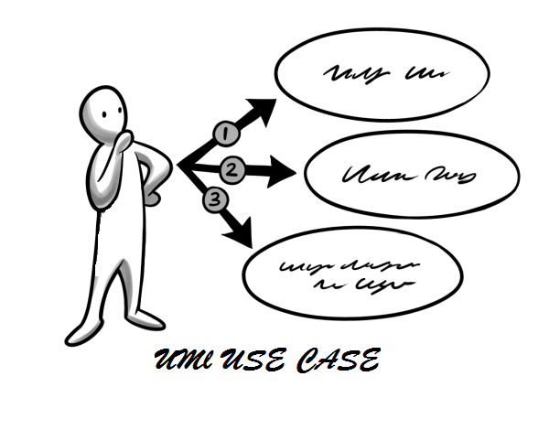
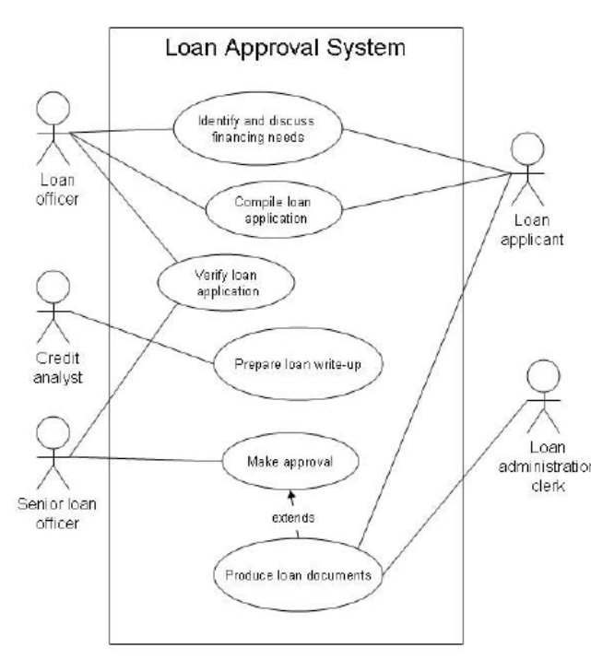
USE CASE DIAGRAM
Use case diagram in general/in normal system :

Slide 7
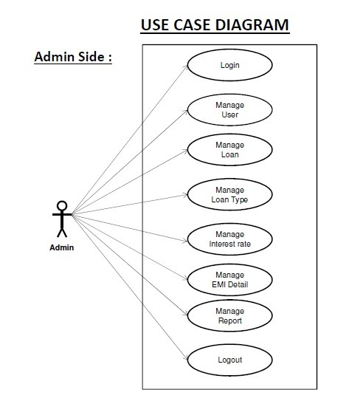
USE CASE DIAGRAM
Use case diagram of our website:

Slide 8
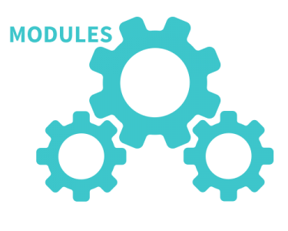
Modules
Admin authentication
User Registration
Blogs
Loans
EMI calculator
Credit calculator
“The size of some one part taken as a unit of measure by which the proportions of an architectural composition are regulated”

Slide 9
Modules description
Admin authentication :
This module is mainly based on admin. System will check the admin user name and password for authentication. After the verification for authorization the admin can be able to precede the process
User Registration :
This module covers the details about the registration of users which they can be register by itself by adding data like name, password, email id and further details. After registration they can be sign in by their username and password
Blogs :
In our web page we have a page called blogs where we can see information about loans.
EMI calculator:
In this page the user is able to calculate his/her EMI
Admin authentication
User Registration
Blogs
EMI calculator
Loans

Slide 10
Modules description
Loans:
In the page the user is able to submit the loan application which he/she want to pursue.
1.personal loan: A personal loan is a type of unsecured loan that that you can borrow from a bank or financial institution if you require funds to pay for your financial needs.
2.home loan: A home loan is a financing solution that you can avail to buy a home with ease. Here, the plot, flat or other property that you are purchasing serves as collateral.
3. vehicle loan: An auto loan allows someone to borrow money to purchase a car or truck. Auto loans are usually simple-interest loans that are to be paid back over a period of typically three or five years.
4. small business loan: An auto loan allows someone to borrow money to purchase a car or truck. Auto loans are usually simple-interest loans that are to be paid back over a period of typically three or five years.
5. Education loan-
A student loan is a type of loan designed to help students pay for post-secondary education and the associated fees, such as tuition, books and supplies, and living expenses. The loan is repaid by the student.
Admin authentication
User Registration
Blogs
EMI calculator
Loans

Slide 11
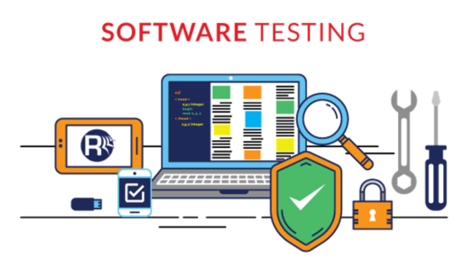
Testing
TYPES OF TESTING:
Testing is commonly divided into several categories, based on how complex the component being tested is. Most of our time will be focused on the lowest level—unit testing—because tests in the other categories operate on pretty much the same principles.
Unit testing
Integration testing
System testing
In our website we are using python for testing in-order to test the modules that we have designed earlier

Slide 12
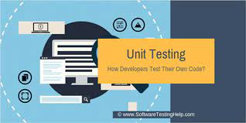
UNIT TESTING
Unit testing
Unit testing is testing of the smallest possible pieces of a program. Often, this means individual functions or methods. The keyword here is individual; something is a unit if it there's no meaningful way to divide it up further.
Unit tests are used to test a single unit in isolation, verifying that it works as expected, without considering what the rest of the program would do. This protects each unit from inheriting bugs from mistakes made elsewhere, and makes it easy to narrow down on the actual problem.

Slide 13

Integration testing
Integration testing
In integration testing, the boundaries of isolation are pushed further back, so that the tests encompass interactions between related units. Each test should still be run in isolation, to avoid inheriting problems from outside, but now the test checks whether the tested units behave correctly as a group.
Integration testing can be performed with the same tools as unit testing.

Slide 14

System testing
System testing
System testing extends the boundaries of isolation even further, to the point where they don't even exist. System tests check parts of the program, after the whole thing has been plugged together. In a sense, system tests are an extreme form of integration tests.
System tests are very important, but they're not very useful without integration tests and unit tests.

Slide 15
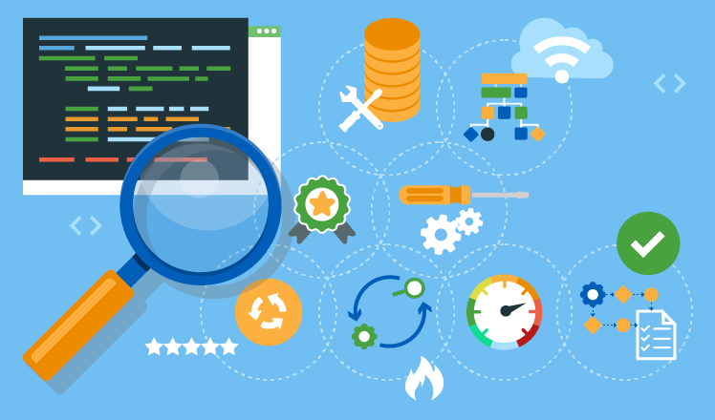
TESTING TECHNIQUE
For our project we would like to use UNIT TESTING and Integration testing
Unit testing is testing of the smallest possible pieces of a program. Often, this means individual functions or methods. The keyword here is individual; something is a unit if it there's no meaningful way to divide it up further.
In integration testing, the boundaries of isolation are pushed further back, so that the tests encompass interactions between related units.

Slide 16
UNIT TESTING FOR LOGIN PAGE
We have used unit testing manually on login page by
Entering valid login ID and password
Enter invalid login ID and password
Empty login ID and & click login

Slide 17
Integration testing (manually)
Test name | Type | Module name | Objective/Test condition | Steps | Test data | Expected result | Actual result
Test_1 | Manual | Integration testing | Verify customer is able to register | 1.Open portal 2.Perform new registration 3.Verify customer details | 1.URL 2.Customer details | Successful registration of user | Successful registration of user
Test_2 | Manual | Integration testing | Verify customer details are updating | Check the details are updating | Check the details are correct or not | Correct information of the user | Correct information of the user

Slide 18
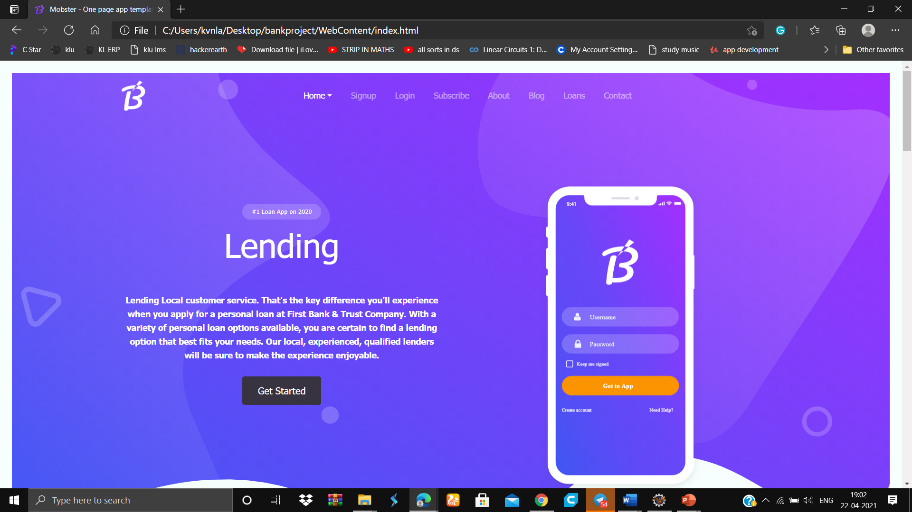

Slide 19
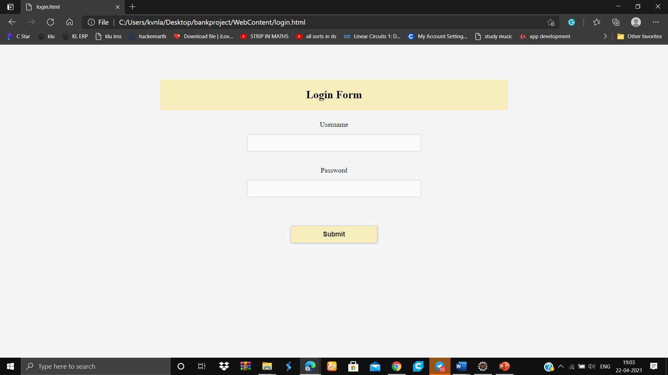

Slide 20
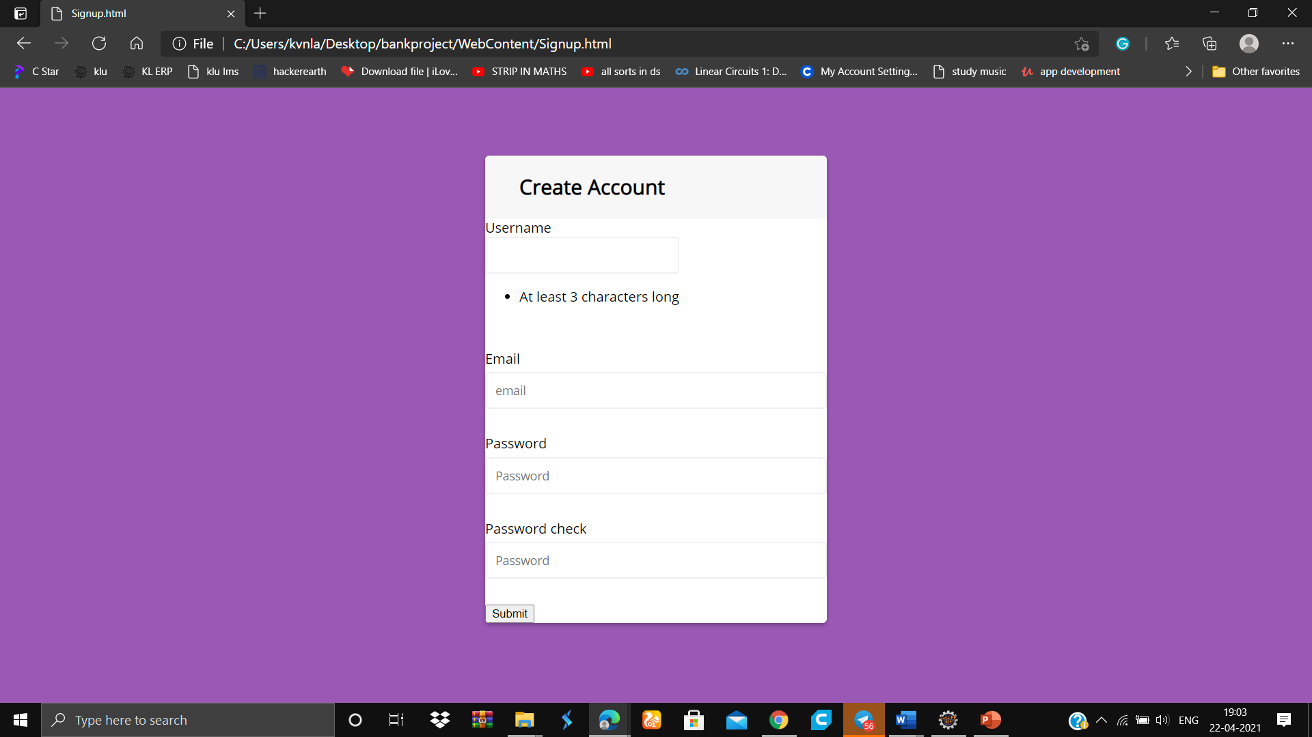

Slide 21
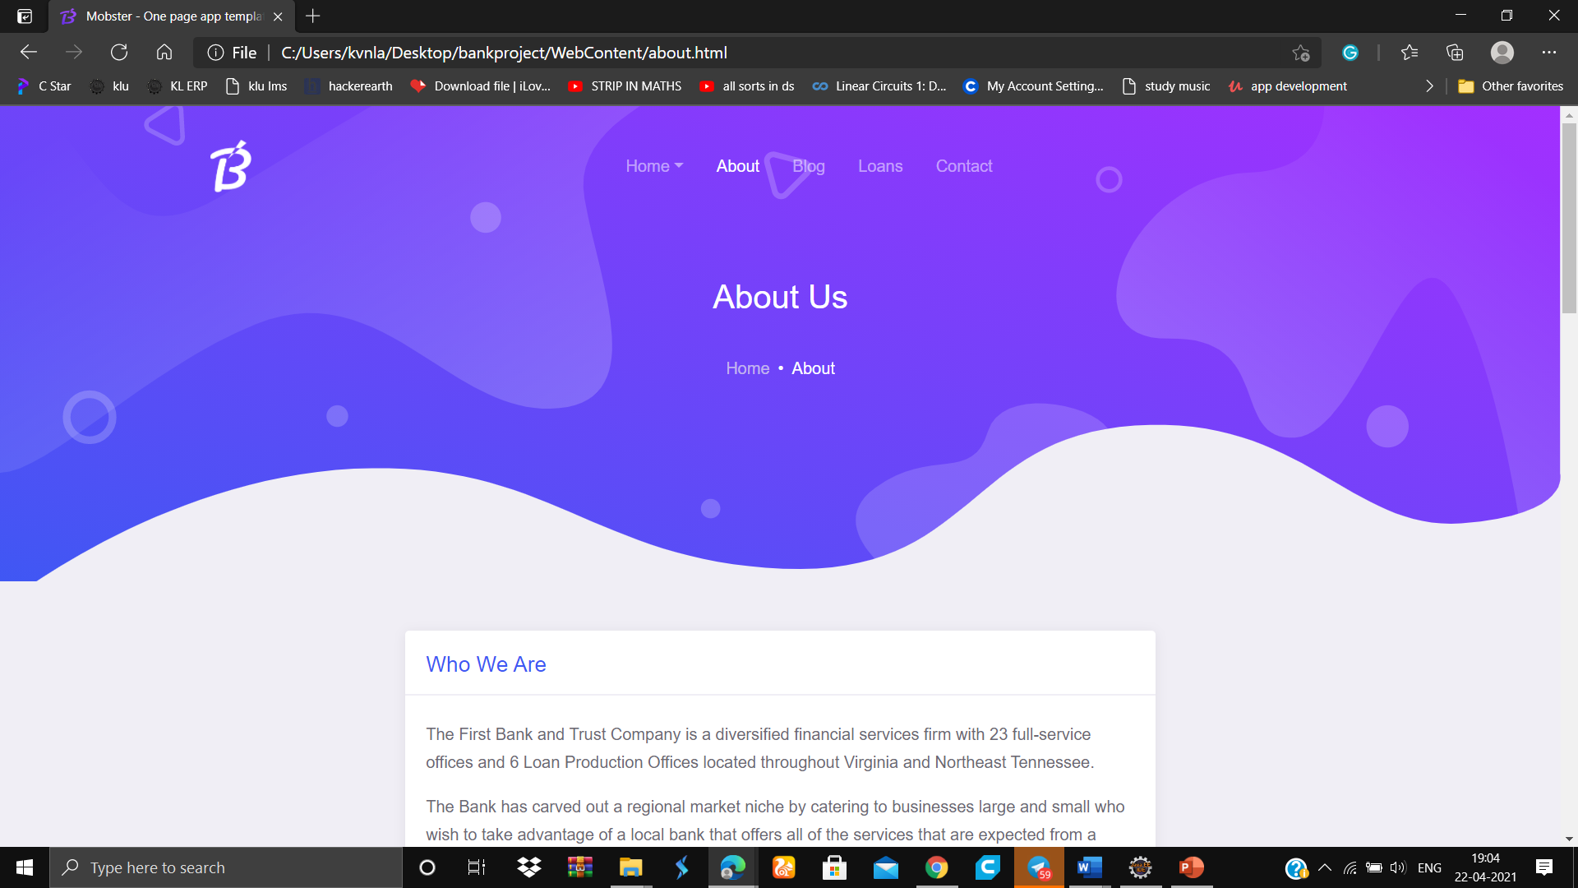
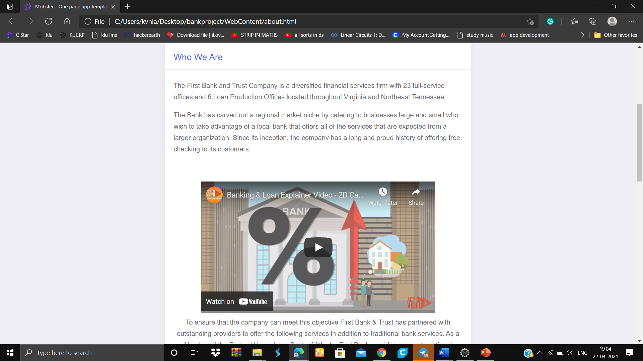
WE HAVE INTEGRATED YOUTUBE VIDEO TO OUR WEB PAGE TO MAKE OUR WEB PAGE LOOK GREAT AND ATTRACTIVE

Slide 22
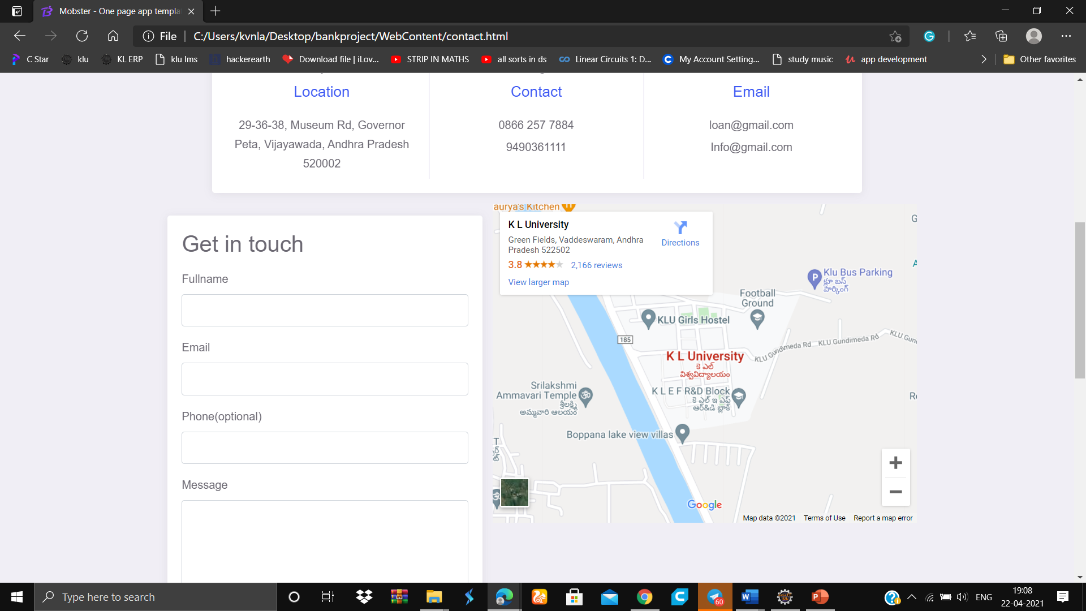
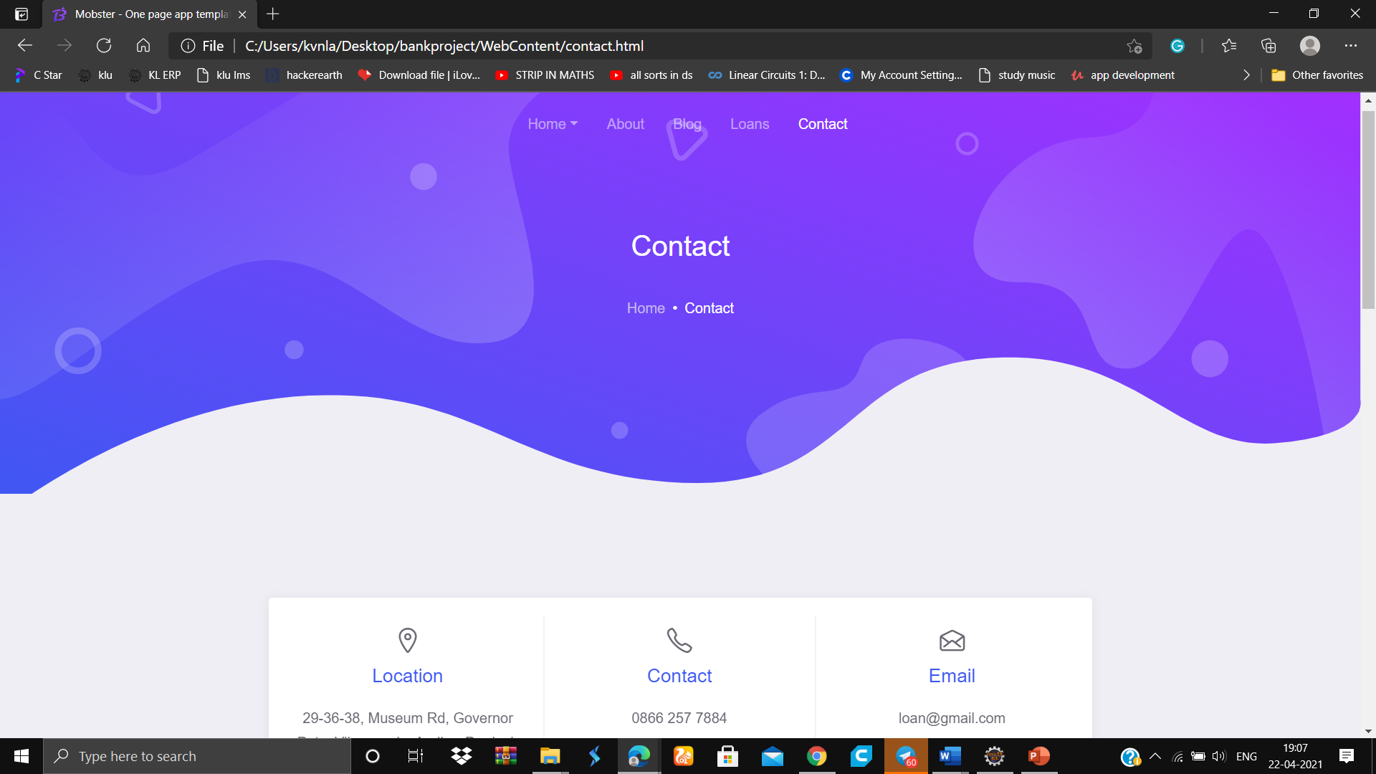
WE HAVE INTEGRATED MAP OF YOU BANK TO OUR WEB PAGE TO MAKE OUR WEB PAGE LOOK GREAT AND ATTRACTIVE AND USER CAN COME TO OUR BANK IF ANY PROBLEM OCCURS

Slide 23

POSTER
The poster describes about our project
It has some key aspects like
Minimum contribution is $5000
Minimum deposit period is 6 months

Slide 25


